Slide 1
Motor cortical and striatal activity during goal-directed reaching
Team Deep Nets:
Darby Losey
Abhinav Sharma
Cathy Su
Akash Umakantha
Elissa Ye

Slide 2
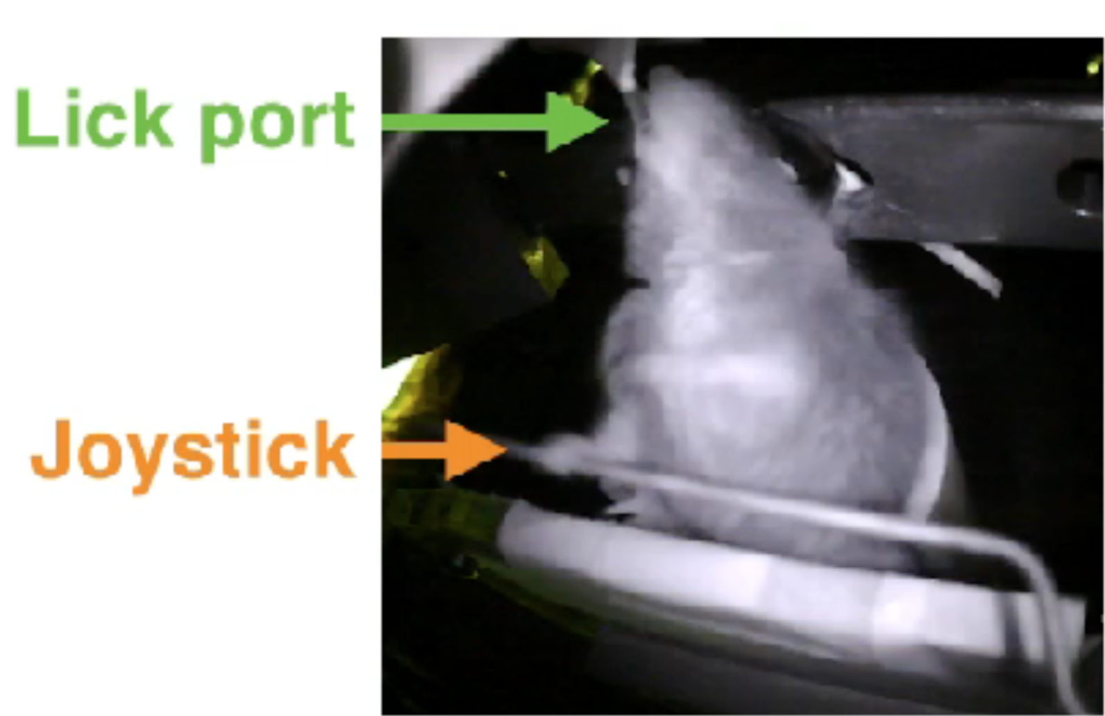
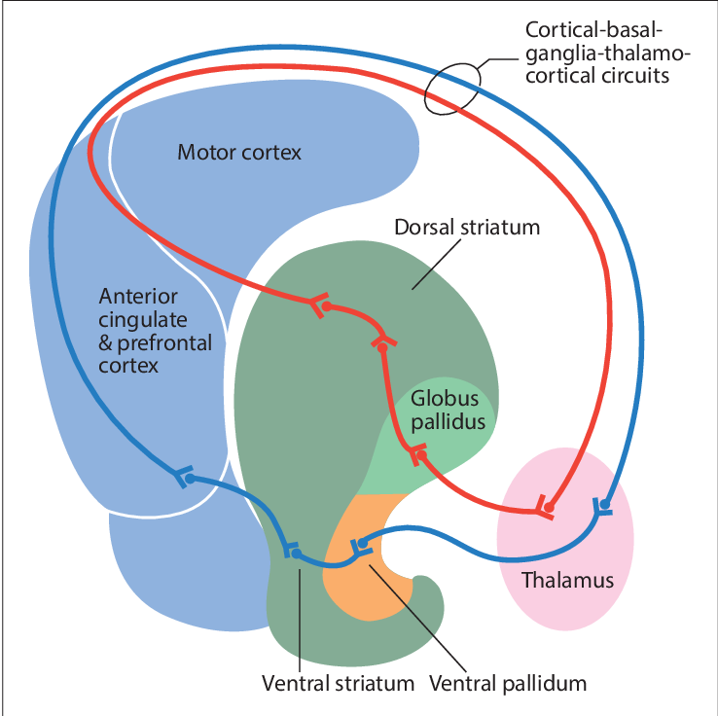
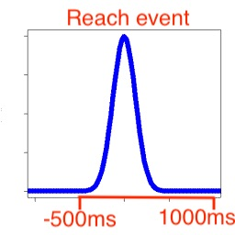
How does neural activity in motor cortex and striatum coordinate to create goal-directed reaching?
Motor
~1.5mm
?
Dorsal
~1.5mm
Ventral
Notes:
Successful press is rewarded by sugar water
Reach can be in any direction (rewarded on Euclidean dist)
Neural activity recorded from -500 to 1000 ms relative to reach
Thought is signal heads from motor cortex to dorsal striatum to ventral

Slide 3
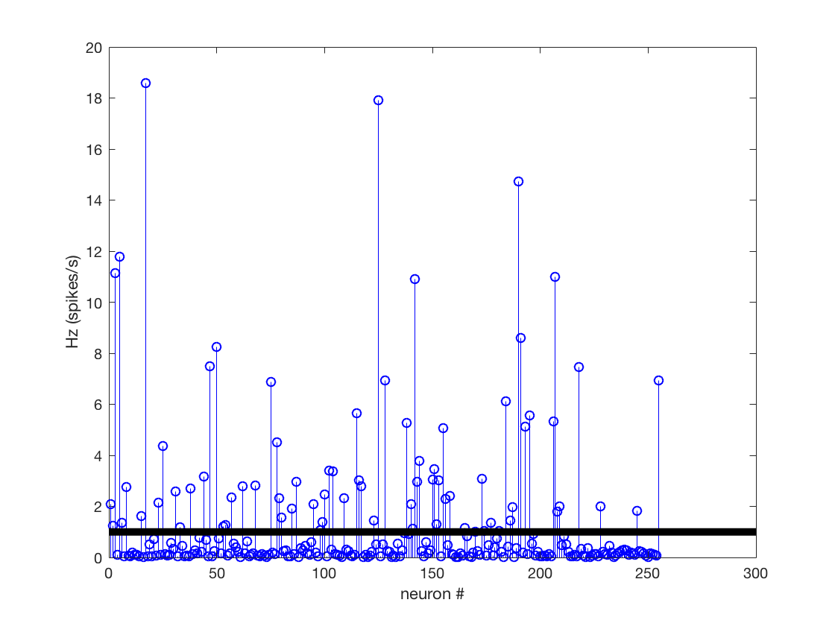
Data Overview and Processing
Mouse1: 163 reaches, Mouse2: 170 reaches
Considered neurons with >1 Hz Firing rate during analysis period:
Mouse1: 2 motor, 49 dorsal striatum, 22 ventral striatum
Mouse 2: 46 motor, 69 dorsal striatum, 66 ventral striatum
Notes:
We considered 163 reaches from mouse 1 and 170 reaches from mouse 2. We only considered neuron that fired above 1 Hz on average (during preparatory and reaching epochs).
Over period of reach, ventral and motor neurons spike in consistent intervals.

Slide 4
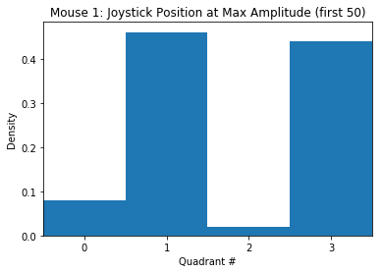
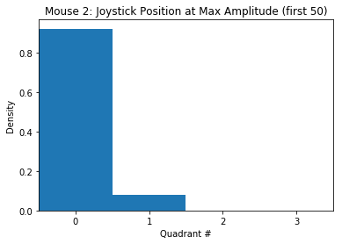
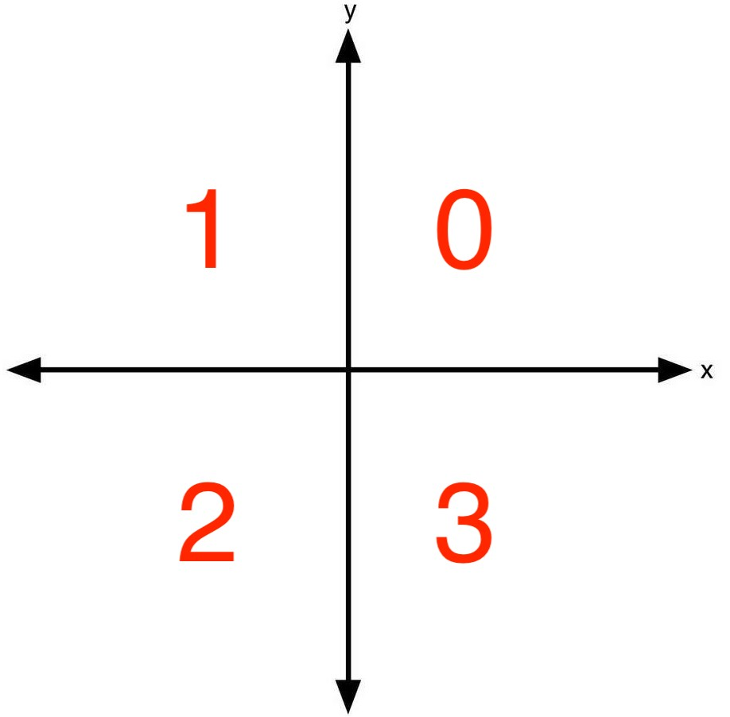
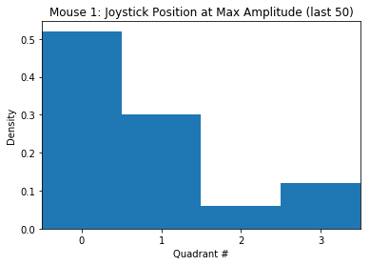
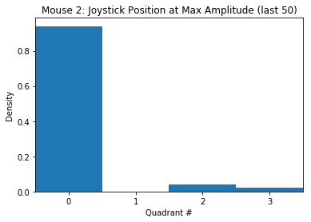
Mouse1 explores different directions while Mouse2 tends to reach into the same direction
Notes:
Quadrant distribution for each mouse at beginning and end of task.

Slide 5
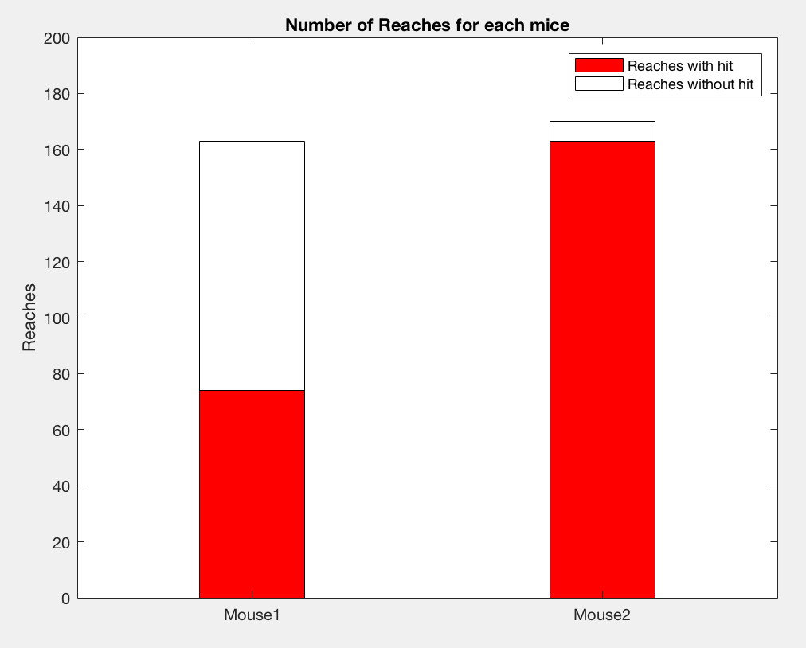
Mouse2 has a higher success rate than Mouse1
Hit rate = 95.88%
Hit rate = 45.4%

Slide 6
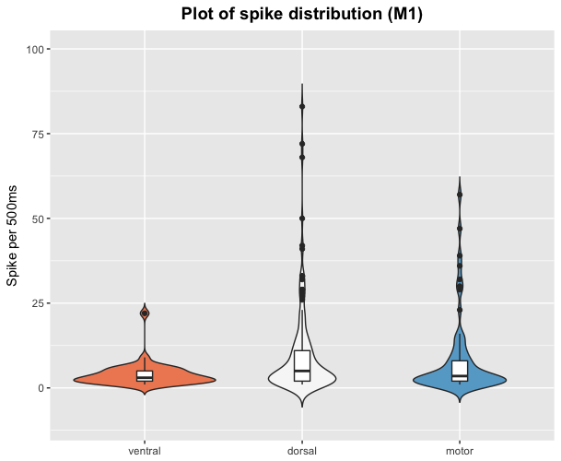
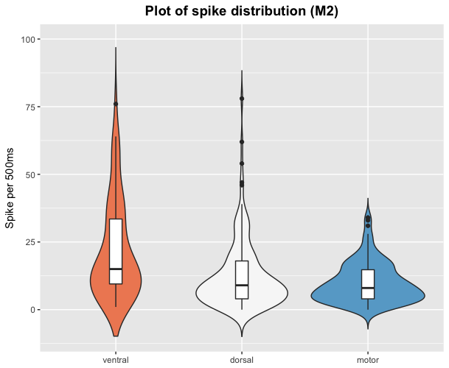
The distribution of action potential firings per neuron varies depending upon neuron type for each mouse
Notes:
Motivated, but Mouse2 is doing automatic movements that are learned (by ventral neurons)
Do you need motor cortex: a difficult task can be done without mice even when their motor cortex has been vacuumed out (Kawai et al. 2015)

Slide 7
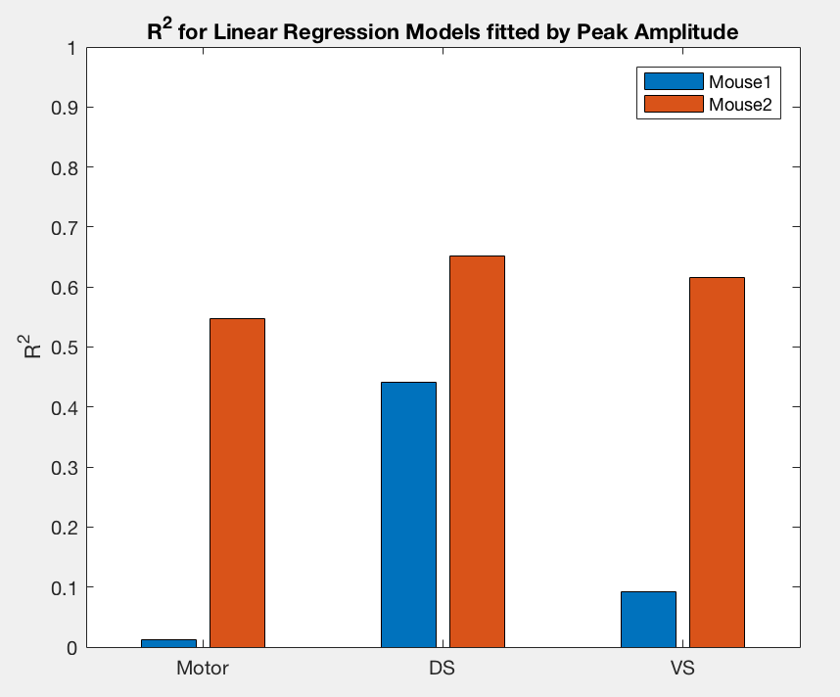
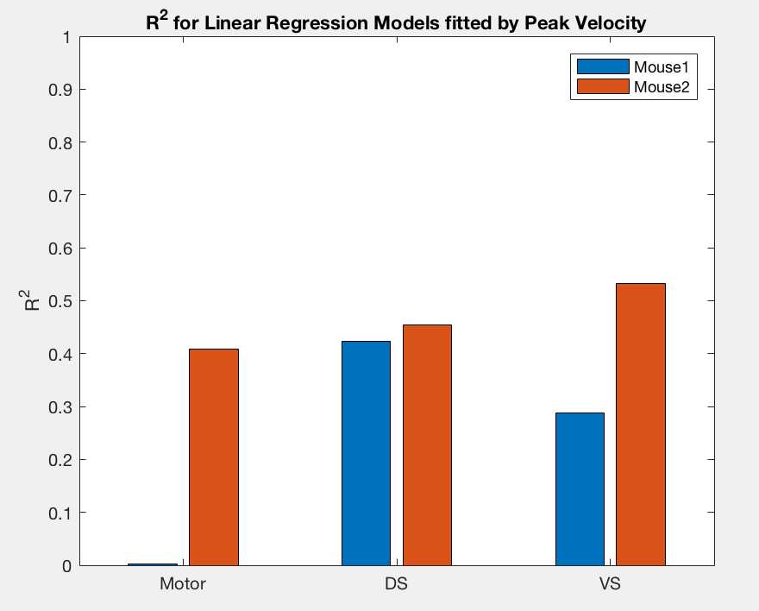
Linear Models for Predicting Peak Amplitude & Velocity
***
***
***
**
*
*
**
***
Ventral striatum better predicts behavior in mouse 2 than mouse 1
Notes:
p-value — p-value for the F-test on the model. For example, the model is significant with a p-value of 7.3816e-27. F-statistic vs. constant model -Test statistic for the F-test on the regression model. It tests for a significant linear regression relationship between the response variable and the predictor variables.
P-values
Peak Amplitude - A/ M1/ M = 0.399,A/ M2/ M = 1.4e-07, A/ M1/ DS = 0.0132, A/ M2/ DS = 2.77e-06, A/ M1/ VS = 0.798,A/ M2/ VS = 1.41e-05
Peak Velocity - V/ M1/ M = 0.818, V/ M2/ M = 0.00396, V/ M1/ DS = 0.0271, V/ M2/ DS = 0.196, V/ M1/ VS = 0.000158, V/ M2/ VS = 0.00421

Slide 8
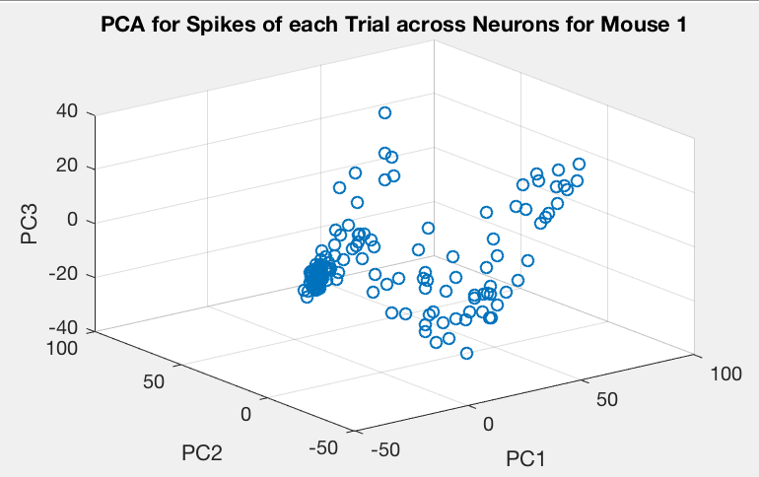
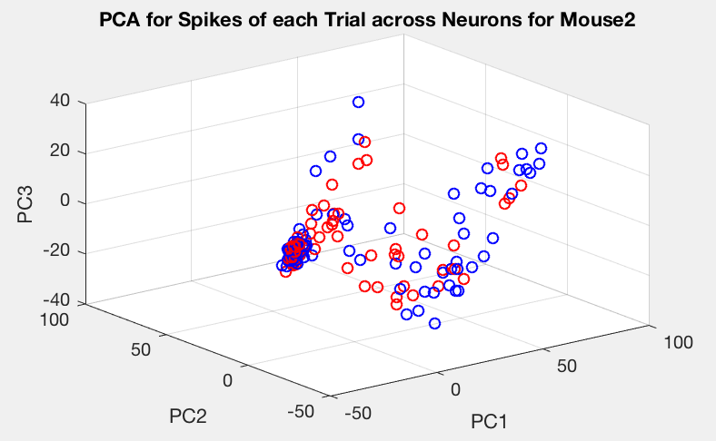
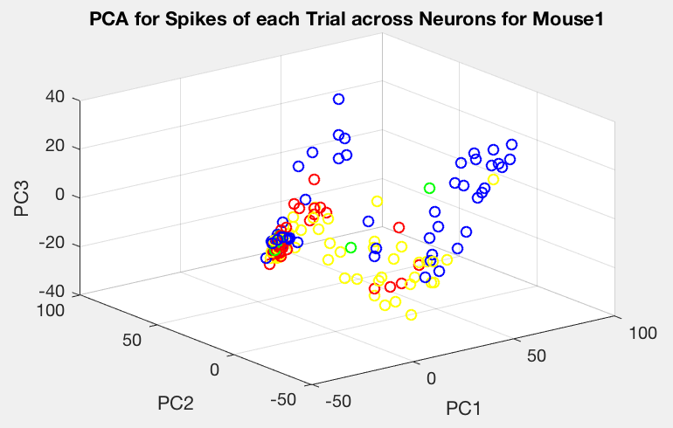
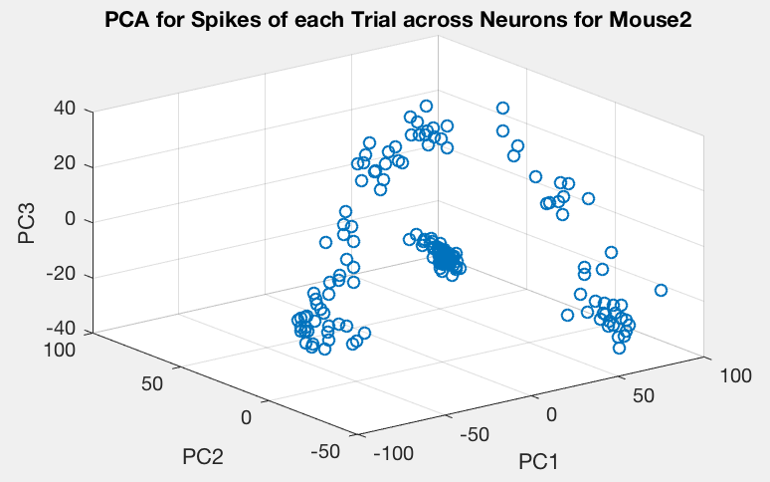
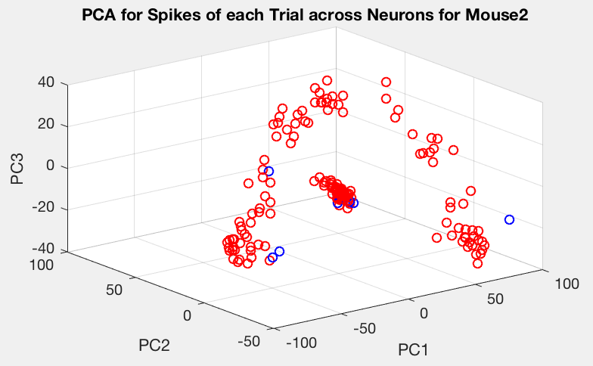
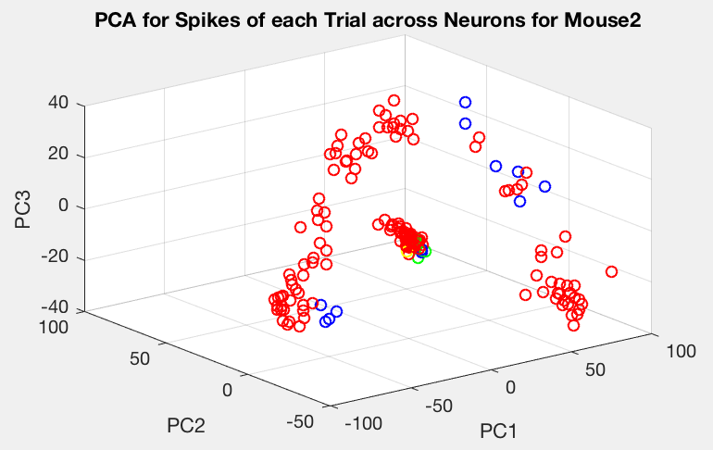
PCA for Spikes per neuron across Trials
No Label
Rewards
Direction
Notes:
Numbers of spikes for each reach across neurons
See obvious clustering
Each datapoint is a reach(trial)
Label by rewards - With Rewards = Red, Without Rewards = Blue - nothing significant
Label by directions - q0= Red, q1= Blue, q2 = green, q3 = yellow - could suggest preference for direction or possibly separated functionally by anatomy

Slide 9
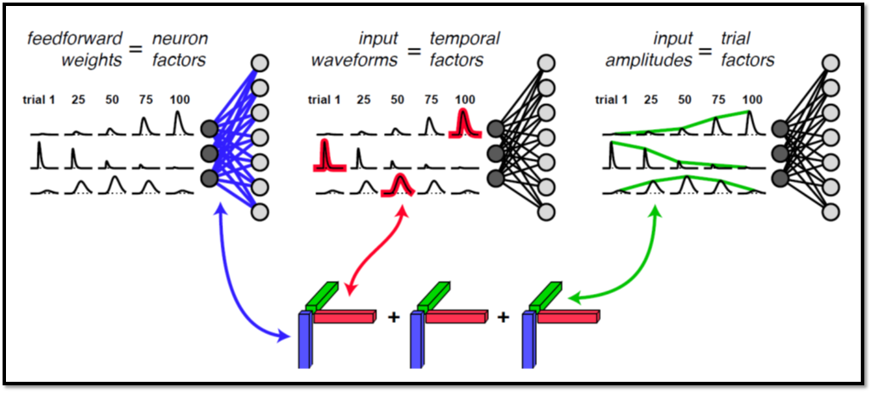
Activity decomposition (neurons x time x trials)
Canonical Polyadic Decomposition( Kolda and Bader 2009)
Notes:
A linear network with gain modulation (e.g. Carandini and Heeger 2012) the modulation can be applied across neurons or across time or across trials

Slide 10
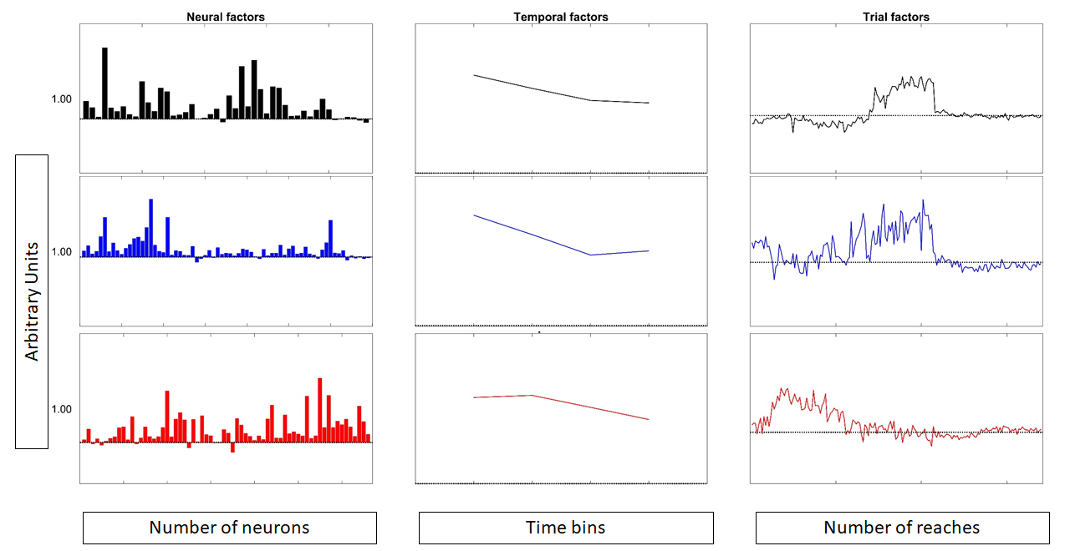
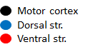
First factor(trial) predicts transition from goal directed to habitual behavior
Notes:
Red is ventral neural data
Blue is dorsal neural data
Black is the motor cortex data
This is all reach only data
This is from mouse 2
Studies investigating functional segregation of the striatum suggest that the ventral striatum is more involved in goal-directed learning, whereas the dorsal striatum is more involved in action related habitual learning (Balleine et al., 2007; Balleine and O'Doherty, 2010; Redgrave et al., 2010); this is consistent with findings in anatomical connectivity of the striatum

Slide 11
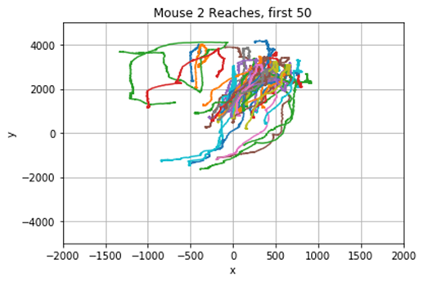
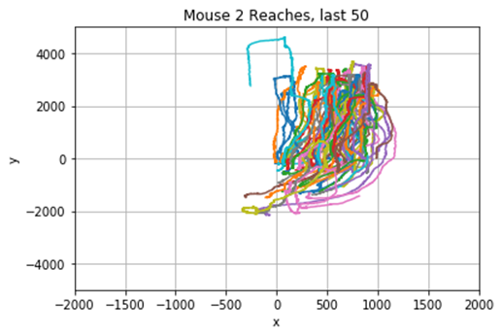
Mouse 2 reaches become more stereotyped with trials
Notes:
Plot of positions for 50 sample reaches (by color)
Mouse 1 has a 50lb

Slide 12
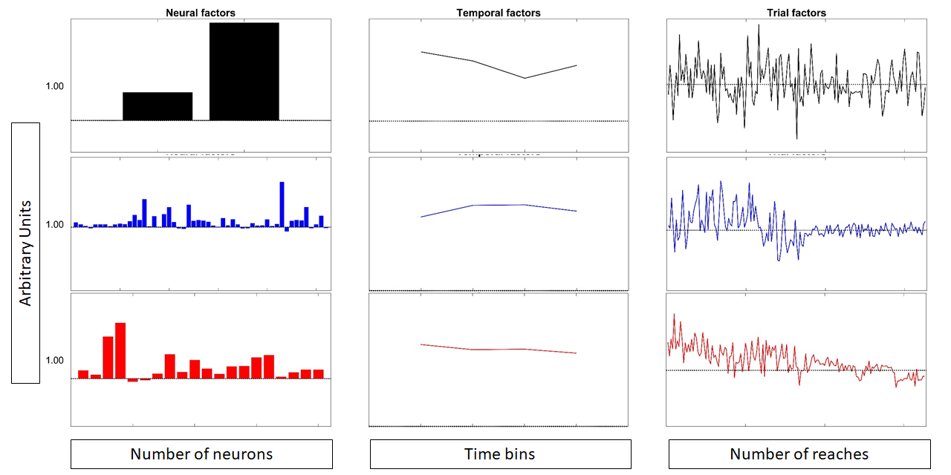
First factor(trial) predicts transition from goal directed to habitual behavior
Notes:
Mouse 1 data

Slide 13
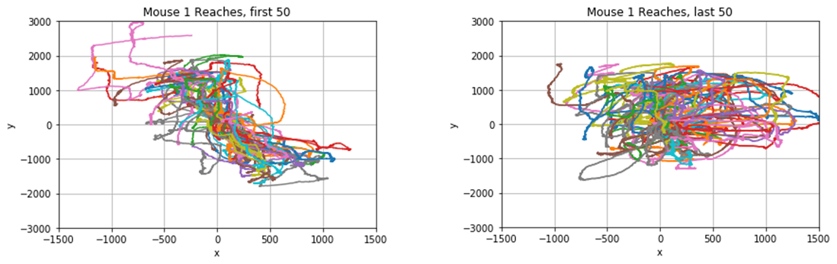
Mouse 1 reaches are variable throughout the session

Slide 14
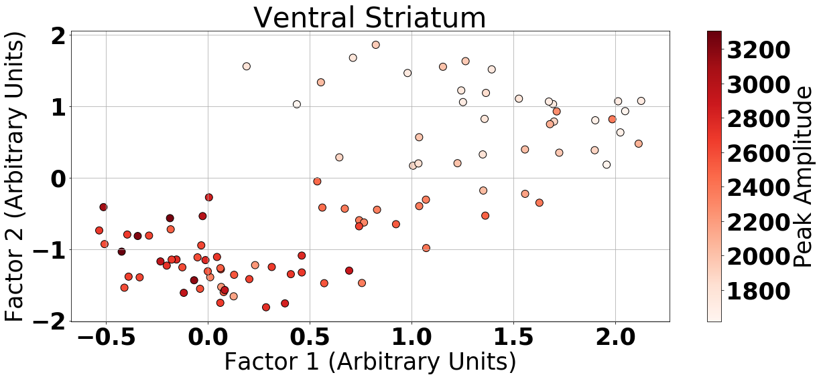
Condition-Invariant Factor Space Predicts Task Performance for Each Brain Area
Notes:
Looking at condition invariant neural activity (neural activity that includes both the reaching preparation and the reach).

Slide 15
How are neurons interacting during goal-directed movements?
How are neurons within a brain area interacting?
Method: graphical lasso to generate conditional independence graphs between neurons
How are neurons between brain areas interacting?
Method: probabilistic CCA to assess correlation and dimensionality of interactions between areas
Is there a difference in interactions during preparation (500 to 0 ms before reach initiation) and actual reach?

Slide 16
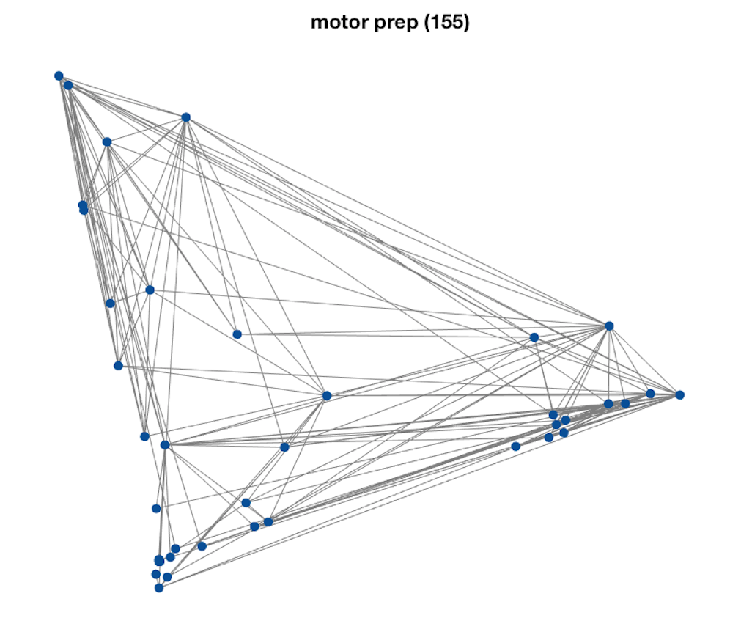
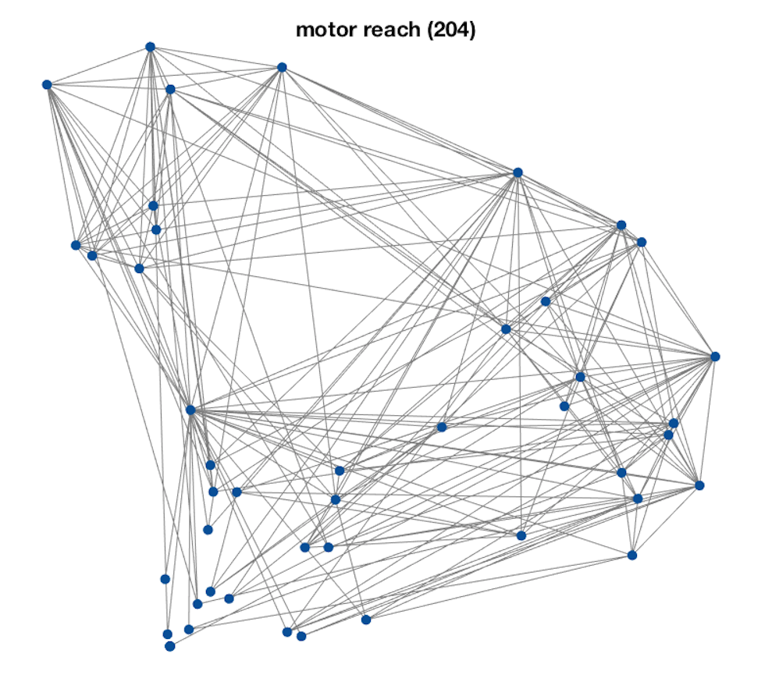
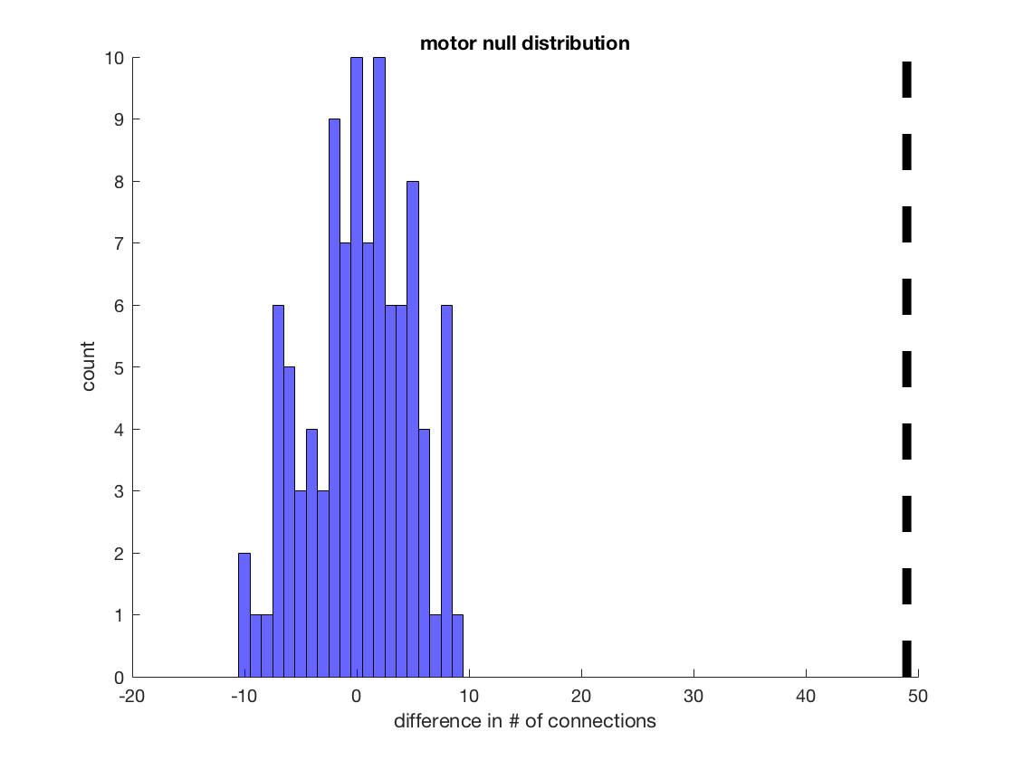
Within-area interactions (glasso) are more prominent during reaching than during preparation
Notes:
Glasso is used to generate conditional independece graphs. Conditional independence: given activity of all other neurons, is there a relationship between these two neurons?
There were more interactions during reaching than preparation (perhaps due to neurons needing to act in a more concerted manner during the actual reaching).
We found the same result in dorsal striatum and ventral striatum as well (see supp slides).

Slide 17
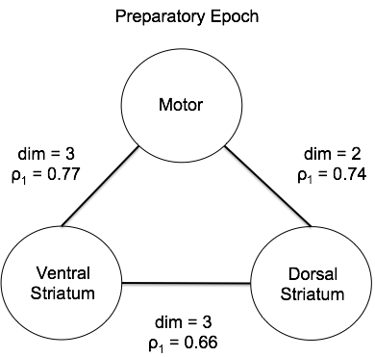
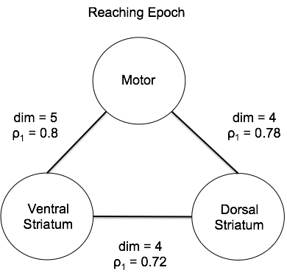
Between-area interactions are higher-dimensional, and stronger during preparation and reaching epochs
Notes:
Probabilistic CCA: used crossvalidation to determine dimensionality of interactions between two brain areas (more dimensions = more interactions). Also inspected the correlation coefficient of the top CCA latent (larger rho1 = stronger interactions).
Dimensionality and correlation increase between all brain areas during reaching epoch
Again, perhaps because neurons need to act in a more concerted manner during the reach

Slide 18
Conclusions
Mouse 2 had comparatively more activity in ventral relative to dorsal and motor neurons
Mouse 2 had a better reward rate and performed more habitual reaches
Low-dimensional activity across trials predicts change from goal-directed behavior for mouse 2, but not mouse 1
Interactions both within a brain area and between brain areas increase during reaching epochs (versus preparatory epochs)

Slide 19
Future Directions
Repeat experiments and analyses with multiple replicates to have higher statistical confidence.
Potential for brain-machine interface: can predict moment-to-moment joystick position and/or joystick velocity based on neural activity
Simpler models: regression, Kalman filtering
Complex model: deep recurrent neural network

Slide 20
Supplemental material

Slide 21
Questions:
Data background/visualization
Decoding movement direction from neural activity
Relationship between velocity and neural activity
Neural activity on a low dimensional manifold
How do neurons interact throughout the reach
Clustering of neurons into functional groups during different parts of the trial
Interactions between neurons in different parts of the trial

Slide 22
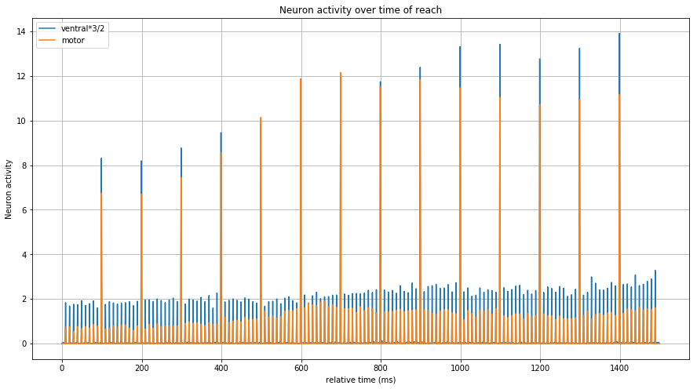
Notes:
Neural activity averaged across Ventral and Motor neurons, for each reach.
Times given relative to reach.

Slide 23
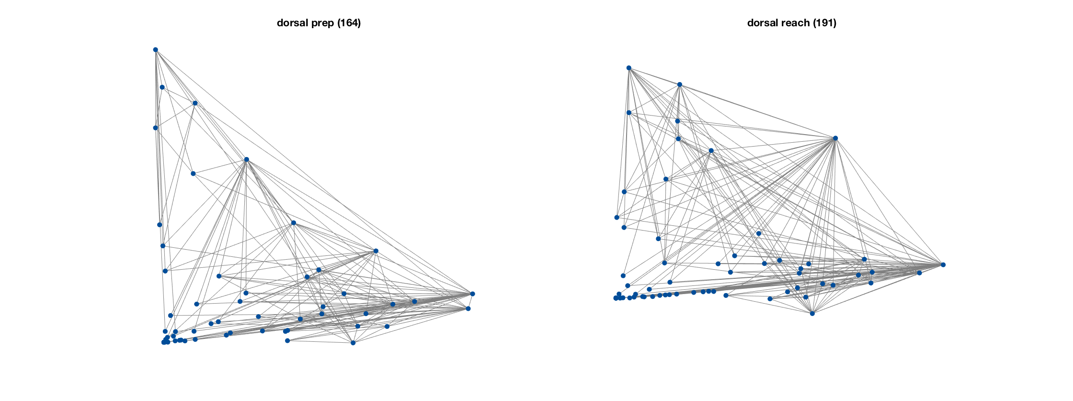
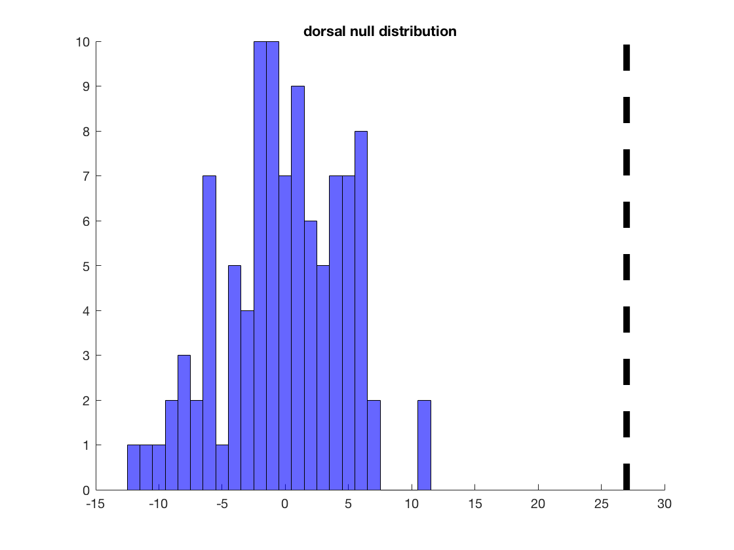
Within area interactions are more prominent during reaching than during preparation (dorsal striatum)

Slide 24
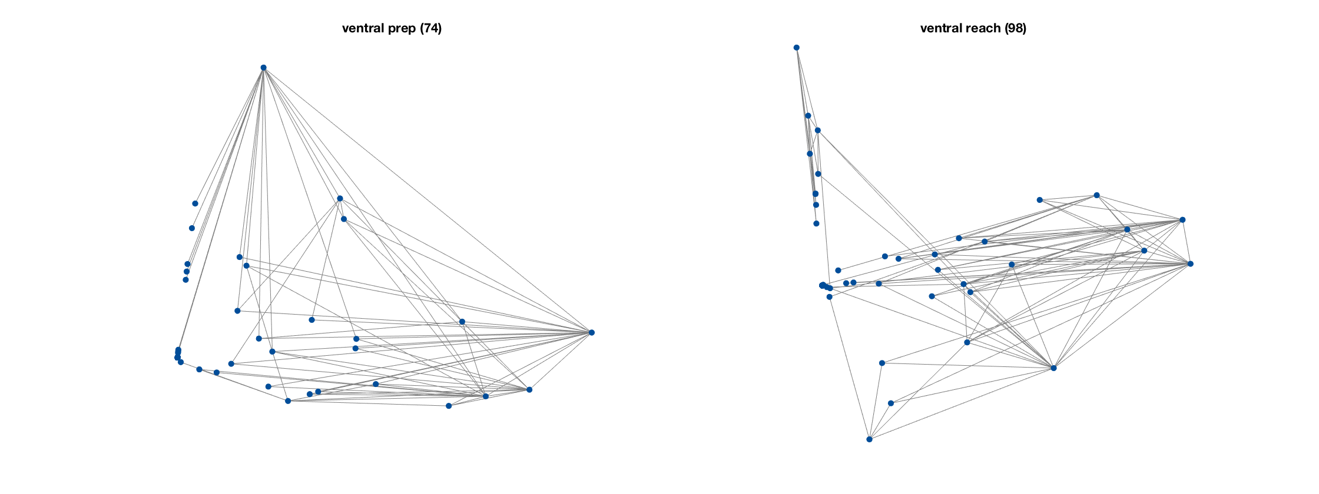
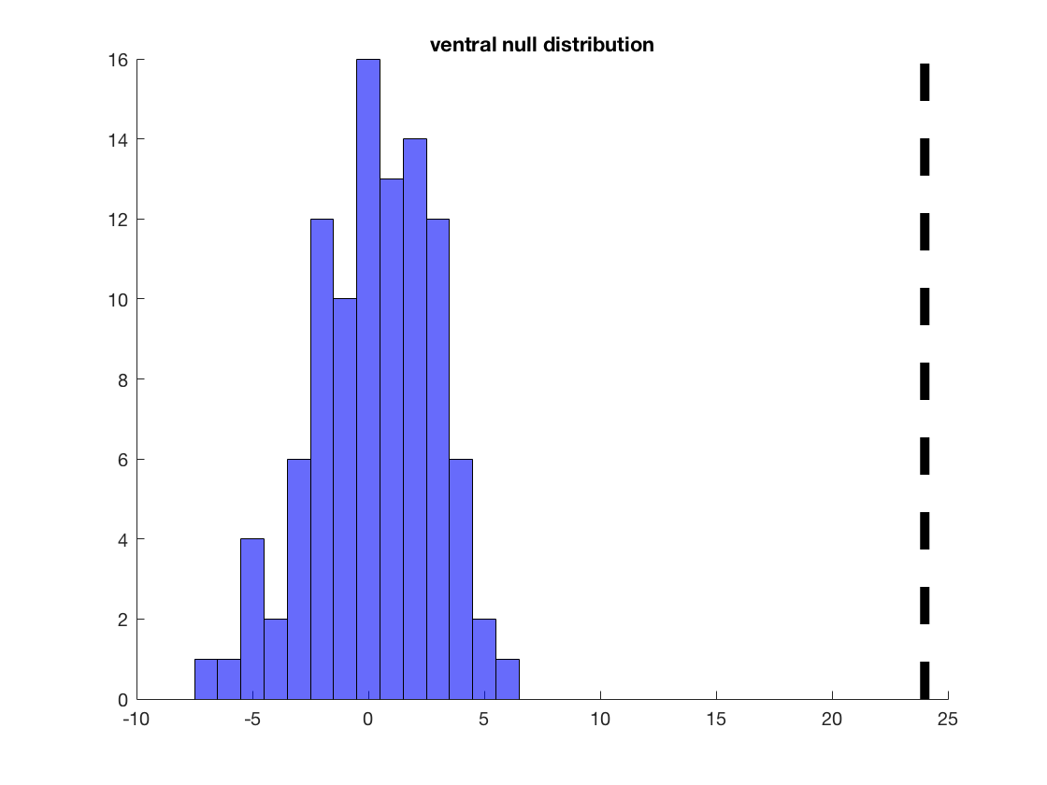
Within area interactions are more prominent during reaching than during preparation (ventral striatum)

Slide 25
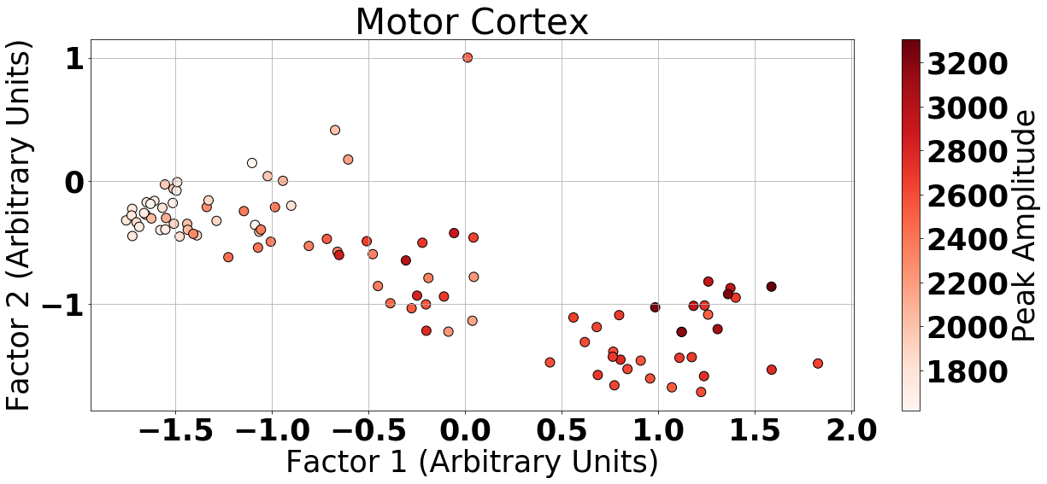
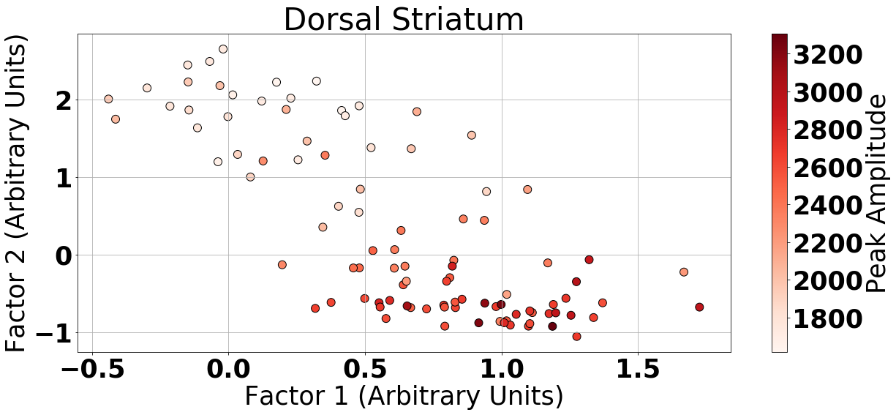
Condition-Invariant Factor Space Predicts Task Performance for Each Brain Area (Supplemental Plots)

